Slide 1
Hyfforddiant Canlyniadau Personol i Ddarparwyr Gofal yn y Cartref
Personal Outcomes Training for Domiciliary Care Providers
Darparu canlyniadau
Pennod 1.3 –
Cysylltu â’r Fframwaith Canlyniadau Cenedlaethol
Delivering outcomes
Chapter 1.3 –
Linking up with the National outcomes framework

Slide 2
Canlyniad Dysgu
Learning Outcome
Adnabod y cyswllt rhwng canlyniadau personol a’r 24 canlyniad llesiant cenedlaethol
Understand how personal outcomes link through to the 24 national well-being outcomes

Slide 3
Fframwaith Canlyniadau Cenedlaethol
National Outcomes Framework
Disgrifio’r canlyniadau llesiant gall bobl sydd angen gofal a chymorth disgwyl er mwyn byw bywyd bodlon
Gosod cyfeiriad cenedlaethol ar gyfer yr holl wasanaethau i weithio gyda phobl er mwyn deall beth sy’n bwysig iddynt
Cynnig dull cyson ar gyfer monitro os ydy gwasanaethau gofal a chymorth yn gwella canlyniadau llesiant i bobl yng Nghymru
Describes the wellbeing outcomes people who need care and support and carers, should expect in order to lead fulfilled lives
Sets a national direction for all services to work with people to understand what matters to them
Provides a consistent approach to monitor if care and support services are improving well-being outcomes for people in Wales
Notes:
SCROLL DOWN FOR ENGLISH NOTES
Mae’r Fframwaith Canlyniadau Cenedlaethol yn galluogi ni i ddilyn cynnydd yn lleol ac yn genedlaethol er mwyn trawsnewid gwasanaethau cymorth a gofal.
Prif amcanion y fframwaith yw:
Disgrifio’r canlyniadau llesiant pwysig gall bobl sydd angen gofal a chymorth, a gofalwyr sydd angen cymorth, disgwyl er mwyn byw bywydau bodlon
Gosod cyfeiriad cenedlaethol ar gyfer yr holl wasanaethau i hybu llesiant pobl Cymru sydd angen gofal a chymorth, a gofalwyr sydd angen cymorth
Bod yn fwy tryloyw pa un ai a yw gwasanaethau yn gwella canlyniadau llesiant i bobl gan ddefnyddio dangosyddion cyson a thebyg
**************************************************************************************************************************************************************************************
The National Outcomes Framework enables progress to be followed both locally and nationally towards transforming care and support services.
The main objectives for the framework are:
Describe the important well-being outcomes that people who need care and support and carers who need support should expect in order to lead fulfilled lives
Set national direction for services to promote the well-being of people in Wales who need care and support, and carers who need support
Provide greater transparency on whether care and support services are improving well-being outcomes for people using consistent and comparable indicators.

Slide 4
Fframwaith Canlyniadau Cenedlaethol: newidiadau allweddol
National Outcomes Framework: Key changes
Symud o:
Sgyrsiau sy’n dilyn arddull sefydlog, ac sy’n cael eu dylanwadu gan anghenion y sefydliad
Tuag at:
Cyfres o sgyrsiau grymuso sydd wedi’u dylunio i fod yn addas ar gyfer pob unigolyn, a system sy’n cefnogi’r ffordd newydd hwn o weithio e.e. gwaith papur addas, systemau TG a’r prosesau a ddefnyddir i wneud penderfyniadau rheoli
A Shift from:
Conversations following a fixed style, influenced by organisational need
To:
A series of empowering conversations designed to be suitable for each individual and a system that supports this new way of working e.g. suitable paperwork, IT systems and management decision making processes
Notes:
SCROLL DOWN ENGLISH NOTES
Mae’r Ddeddf Gwasanaethau Cymdeithasol a Llesiant (Cymru) 2014 yn gofyn am newid anferth yn y ffordd rydyn ni’n darparu gofal a chymorth.
Symud oddi wrth berthynas sy’n cael ei arwain gan brosesau ac sy’n tywys staff i gael math penodol o sgwrs er mwyn ateb y cwestiynau sy’n ofynnol gan sefydliadau ac sy’n ymateb, felly, i ofynion y system yn hytrach na chanolbwyntio ar ddeall yr unigolyn a’r teulu
Tuag at alluogi sgyrsiau sy’n ceisio deall amgylchiadau unigryw a system sy’n cefnogi’r ffordd hwn o weithio.
Er mwyn i hwn digwydd rhaid i’r systemau cyfredol newid. Hynny yw, newid yn y gwaith papur, systemau TchG ayyb. Mae hwn yn cael ei drafod yn sleidiau 4/5. Mae’n golygu hefyd bod rhaid i “ddiwylliant ymddygiad” darparwyr newid.
************************************************************************************************************************************************************************************************
The Social Services and Well-being (Wales) Act 2014 requires a huge shift in how we deliver care and support.
Moving from heavily process driven relationship that lead staff to a particular style of conversation in order to answer the questions the organisation demands of them and therefore responding to the needs of the system rather than focussing more on understanding the person and family.
To empowering conversations designed to understand each unique set of circumstances and a system that supports that approach.
For this to happen, there needs to be a change within current systems, i.e. a change to paperwork and IT systems, etc. This is covered in slide 4/5. It also means that the ‘behaviour and culture’ of providers need to change.

Slide 5
Fframwaith Canlyniadau Cenedlaethol: newidiadau allweddol
National Outcomes Framework: Key changes
Symud o:
Ymateb i anghenion y system yn hytrach na gwario mwy o amser yn gwrando ar, a cheisio deall, y person au teulu
Tuag at:
Sgyrsiau hyfedr, ystyriol sy’n canolbwyntio ar ddatrys problemau, gweithio gyda’n gilydd i gyflawni canlyniadau, cynyddu dewis, rheolaeth, annibyniaeth a chryfderau
A Shift from:
Responding to the needs of the system rather than spending more time listening to and understanding the person and their family
To:
Skilled, thoughtful conversations that focus on problem solving, working together to achieve outcomes, maximising choice, control, independence and strengths
Notes:
SCROLL DOWN ENGLISH NOTES
Mae’r Ddeddf Gwasanaethau Cymdeithasol a Llesiant (Cymru) 2014 yn gofyn am newid anferth yn y ffordd rydyn ni’n darparu gofal a chymorth.
Symud oddi wrth berthynas sy’n cael ei arwain gan brosesau ac sy’n tywys staff i gael math penodol o sgwrs er mwyn ateb y cwestiynau sy’n ofynnol gan sefydliadau ac sy’n ymateb, felly, i ofynion y system yn hytrach na chanolbwyntio ar ddeall yr unigolyn a’r teulu
Tuag at alluogi sgyrsiau sy’n ceisio deall amgylchiadau unigryw a system sy’n cefnogi’r ffordd hwn o weithio.
Er mwyn i hwn digwydd rhaid i’r systemau cyfredol newid. Hynny yw, newid yn y gwaith papur, systemau TchG ayyb. Mae hwn yn cael ei drafod yn sleidiau 4/5. Mae’n golygu hefyd bod rhaid i “ddiwylliant ymddygiad” darparwyr newid.
*************************************************************************************************************************************************************************************************
The Social Services and Well-being (Wales) Act 2014 requires a huge shift in how we deliver care and support.
Moving from heavily process driven relationship that lead staff to a particular style of conversation in order to answer the questions the organisation demands of them and therefore responding to the needs of the system rather than focussing more on understanding the person and family.
To empowering conversations designed to understand each unique set of circumstances and a system that supports that approach.
For this to happen, there needs to be a change within current systems, i.e. a change to paperwork and IT systems, etc. This is covered in slide 4/5. It also means that the ‘behaviour and culture’ of providers need to change.

Slide 6
Canlyniadau personol | Canlyniadau Llesiant Cenedlaethol | Personal Outcomes | National Well-being Outcomes
Rydw i eisiau teimlo’n lân ac yn ffres er mwyn teimlo’n hyderys a mwynhau gwario amser gyda fy wyrion | Domestig, teulu a pherthnasau personol | I want to smell clean and feel fresh so I feel confident and can enjoy spending time with my grandchildren | Domestic, family and personal relationships
Rydw i eisiau aros a byw yn fy nghartref fy hun, ble cefais fy magu | Priodoldeb llety | I want to stay and live in my own home, where I grew up | Suitability of living accommodation
Gan fod fy nheulu’n dod o India rwy’n dwlu ar gael oglau sbeis yn y tŷ. Hoffwn i fwyta’r bwyd roedd fy nheulu’n coginio | Iechyd a llesiant corfforol, meddlyliol ac emosiynol | As my family is from India, I love having the house smell of different fresh spices. I want to eat food that my family used to cook | Physical and mental health and emotional well-being
Notes:
SCROLL DOWN ENGLISH NOTES
Mae hwn yn esiampl o sut gall ganlyniadau personol cefnogi’r Canlyniadau Llesiant Cenedlaethol
Weithiau gall ganlyniad personol unigolyn gefnogi nifer o Ganlyniadau Llesiant Cenedlaethol. Fodd bynnag, mae’n bosib y gall eu canlyniadau ond cefnogi un o’r Canlyniadau Llesiant Cenedlaethol
************************************************************************************************************************************************************************************************
Personal outcomes must link through to the 24 national well-being outcomes stated in the well-being statement.
Sometimes an individual’s personal outcome may support several national Well-being Outcomes, however, it is possible that their personal outcome may only support one of the National Well-being Outcomes.

Slide 7
Notes:
SCROLL DOWN FOR ENGLISH NOTES
Mae’r tablau hyn yn dangos y diffiniad o “beth mae llesiant yn ei olygu”, o Rhan 2 o’r Deddf Gwasanaethau Cymdeithasol a Llesiant, a’r canlyniadau llesiant cyfatebol.
Rheolaeth dros fywyd bob dydd – gwelwch 1.1, sleid 12 (cawod cerdded I mewn) – mae hwn yn esiampl o sut gall ganlyniad personol cefnogi’r Fframwaith Canlyniadau Cenedlaethol.
*************************************************************************************************************************************************************************************
These tables shows the definition of ‘what well-being means’, from Section 2 of the Social Services and Well-being Act, and the corresponding national well-being outcomes:
Control over day-to-day life – see 1.1 slide 12 (walk in shower) - this is an example how what’s important to individual can support National Outcomes Framework.

Slide 8
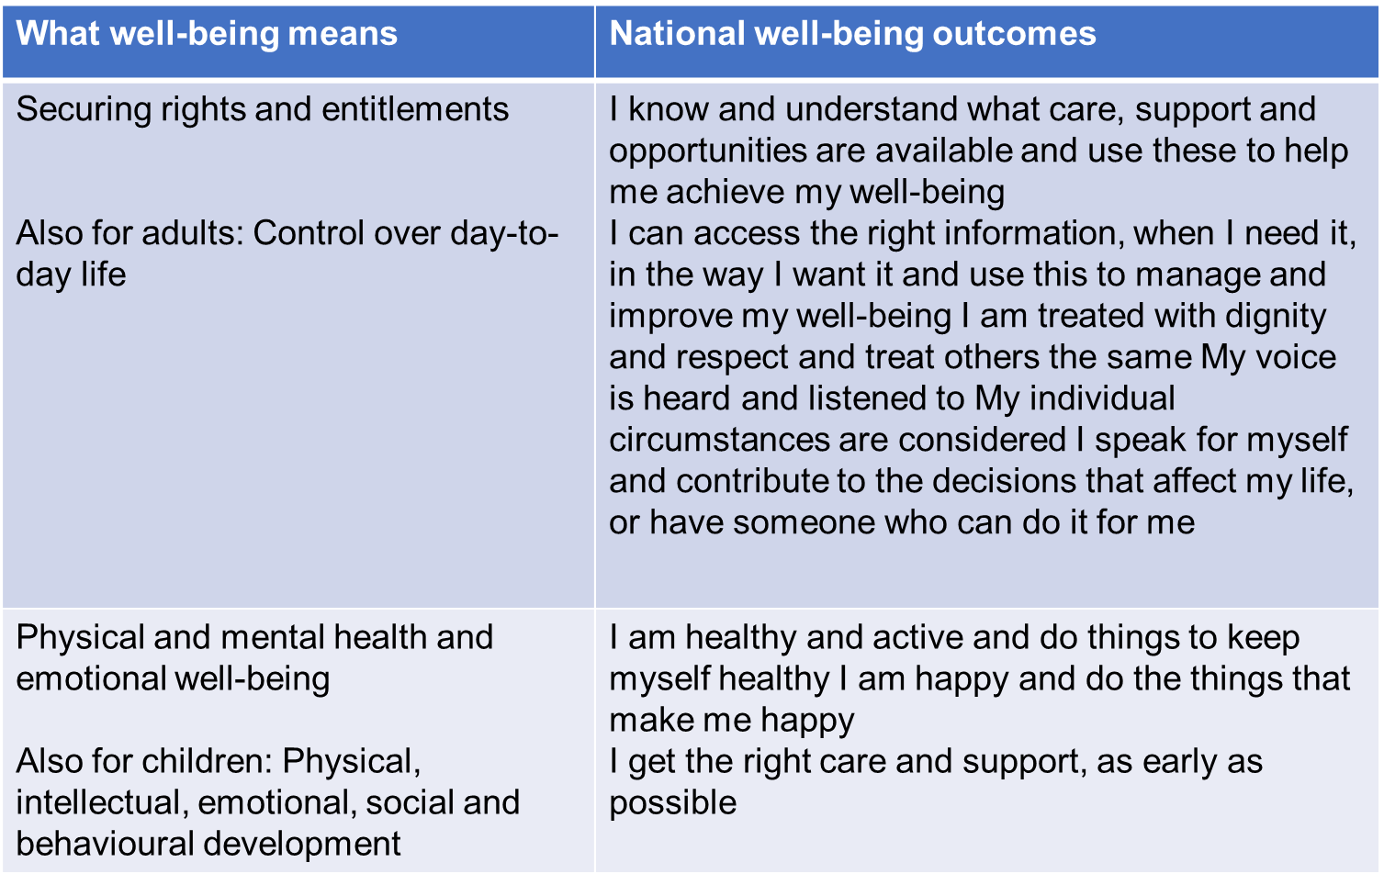
Notes:
SCROLL DOWN FOR ENGLISH NOTES
Mae’r tablau hyn yn dangos y diffiniad o “beth mae llesiant yn ei olygu”, o Rhan 2 o’r Deddf Gwasanaethau Cymdeithasol a Llesiant, a’r canlyniadau llesiant cyfatebol.
Rheolaeth dros fywyd bob dydd – gwelwch 1.1, sleid 12 (cawod cerdded I mewn) – mae hwn yn esiampl o sut gall ganlyniad personol cefnogi’r Fframwaith Canlyniadau Cenedlaethol.
*************************************************************************************************************************************************************************************
These tables shows the definition of ‘what well-being means’, from Section 2 of the Social Services and Well-being Act, and the corresponding national well-being outcomes:
Control over day-to-day life – see 1.1 slide 12 (walk in shower) - this is an example how what’s important to individual can support National Outcomes Framework.

Slide 10
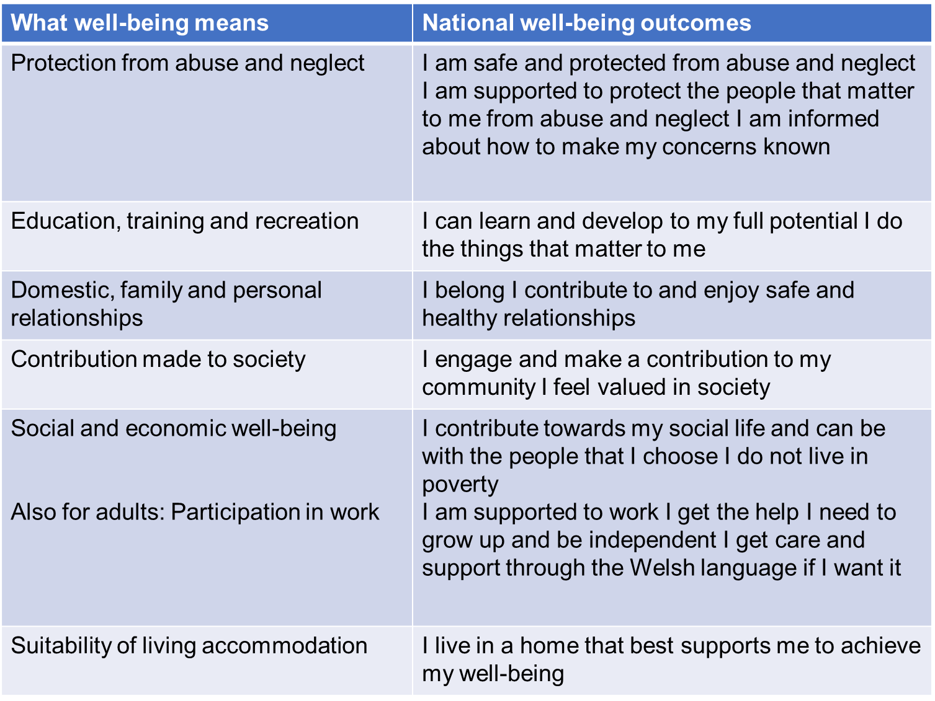

Slide 11
Cwestiynau i chi feddwl am
Suggested questions for you to think about
Meddyliwch am ganlyniad rydych chi’n helpu rhywuniI weithio tuag ato. Sut mae’n ffitio gyda’r Fframwaith Canlyniadau Cenedlaethol?
Think of an outcome that you’re supporting someone to work towards. How does it fit with the National Outcomes Framework?
Notes:
Trafodaeth grwp
*******************
Group discussion

